Slide 1
IAB/PwC Internet Advertising Revenue Report Detailed Analysis
Full Year 2016 and Q4 2016
April 2017
David Silverman, Partner, PwC

Slide 2
IAB Internet Advertising Revenue Report
www.pwc.com www.iab.com
2016 full year results
Any trademarks included are trademarks of their respective owners and are not affiliated with, nor endorsed by, PricewaterhouseCoopers LLP.

Slide 3
Agenda
Survey methodology
2016 full year results
Full year and quarterly trends
Advertising formats
Digital video
Social media
Digital Audio
Pricing models
Industry category spending
About PwC

Slide 4
Survey Methodology
Survey Scope
The IAB Internet Advertising Revenue Report is part of an ongoing IAB mission to provide an accurate barometer of Internet advertising growth.
To achieve differentiation from existing estimates and accomplish industry-wide acceptance, key aspects of the survey include:
Obtaining historical data directly from companies generating internet (desktop and mobile) advertising revenues;
Making the survey as inclusive as possible, encompassing all forms of internet advertising, including websites, consumer online services, ad networks and exchanges, mobile devices; and
Ensuring and maintaining a confidential process, only releasing aggregate data.
Methodology
Throughout the reporting process, PwC:
Compiles a database of industry participants selling internet advertising revenues.
Conducts a quantitative mailing survey with leading industry players, including web publishers, ad networks, commercial online service providers, mobile providers, and other online media companies.
Requests and compiles several specific data items, including monthly gross commissionable advertising revenue by industry category and transaction.
Acquires supplemental data through the use of publicly disclosed information.
Identifies non-participating companies and applies a conservative revenue estimate based on available public sources.
Analyzes the findings, identifies and reports key trends.

Slide 5
Annual revenues totaled…
In billions

Slide 6
Annual revenues totaled $72.5 billion in 2016
Online advertising revenue increased $12.9 billion in 2016
In billions

Slide 7
Fourth quarter revenues totaled…
In billions

Slide 8
Fourth quarter revenues totaled $21.6 billion in 2016
Revenue in Q4 2016 was $4.2 billion higher than in Q4 2015
24.3%
In billions

Slide 9
Strong growth between Q3 2016 and Q4 2016
In billions

Slide 10
Strong growth between Q3 2016 and Q4 2016
Revenue in Q4 2016 was $3.4 billion higher than in Q3 2016
18.9%
In billions

Slide 11
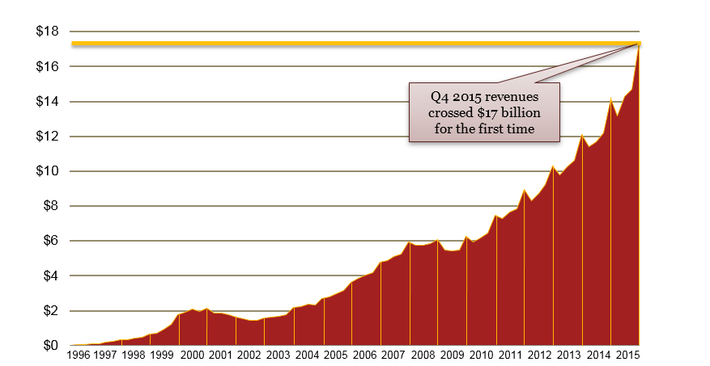
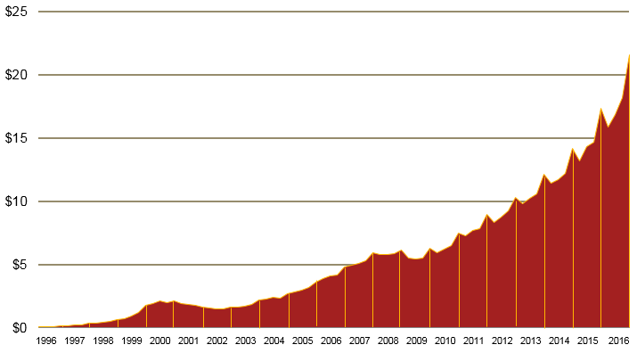
Quarterly growth continues upward trend Quarterly growth comparison, 1996–2016
In billions

Slide 12
2016 showed record revenues Annual revenue 2006-2016
16% Overall CAGR
In billions
* CAGR: Compound Annual Growth Rate

Slide 13
2016 showed record revenues Annual revenue 2006-2016
87%
Mobile
CAGR
6% Non-mobile CAGR
16% Overall CAGR
In billions
* CAGR: Compound Annual Growth Rate

Slide 14
Historical Revenue Concentrations

Slide 15
Historical trends in internet advertising formats Revenue share by major ad formats, 2008–2016
% of total revenue

Slide 16
Distributing Mobile across formats demonstrates its importance to Search and Display
Formats –2016
(Mobile separated)

Slide 17
Distributing Mobile across formats demonstrates its importance to Search and Display
Formats –2016
(Mobile separated)
Formats –2016
(Mobile included)

Slide 18
2016 saw Video grow and Search take a slight stumble
Formats –2015
(Mobile included)
Formats –2016
(Mobile included)
** Other includes: Classifieds, Lead Generation, and Audio

Slide 19
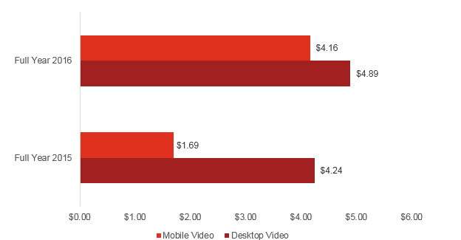
Digital video – The gap between formats is closing Digital video ad revenues, 2015 – 2016
In billions

Slide 20
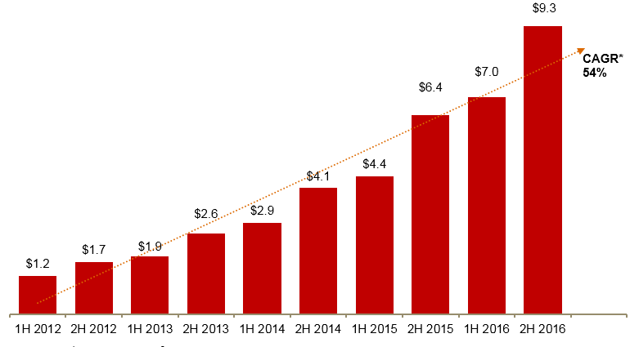
Social media demonstrated continued growth Social media ad revenues, 2012 –2016
In billions
* CAGR: Compound Annual Growth Rate

Slide 21
Social Media and Mobile Impact Percentage of Revenues 2012 - 2016

Slide 22
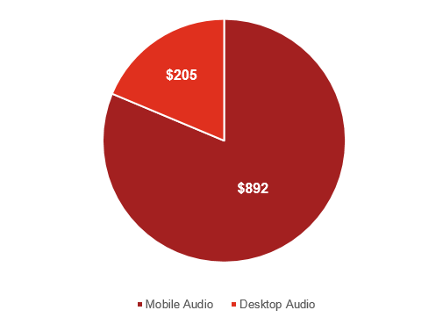
Digital audio makes its report debut Digital audio ad revenues, 2016
Digital audio generated $1.1B in FY 2016; mobile represented 81% of the total
In millions
Source: IAB Internet Advertising Revenue Report, FY 2016

Slide 23
Impression-based pricing showed slight uptick Internet ad revenues by pricing model, 2015 vs. 2016
Total – $59.6 billion
Total – $72.5 billion

Slide 24
Historical pricing model trends Internet ad revenues by pricing model, 2005–2016
% of total revenue
Note: Pricing model definitions may have changed over the time period depicted both within the survey process and as interpreted by respondents

Slide 25
Internet ad revenues by major industry category
% of total revenue †
† Amounts do not total to 100% as minor categories are not displayed.

Slide 26
Technology and Entertainment, Media, and Communications practices
Contacts
For information, contact one of the following PwC professionals:
New York
David Silverman
Partner, Assurance Services
646.471.5421
david.silverman@pwc.com
York
Russ Sapienza
Partner, Advisory Services
646.471.1517
russell.j.sapienza@pwc.com
Brian Gaffney
Manager, Advisory Services
646.471.4722
brian.gaffney@pwc.com
April 2017

