Slide 1
Innovator Roundtable Dinners
Growing Revenue
Global Summit
October, 2012

Slide 2
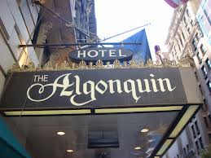
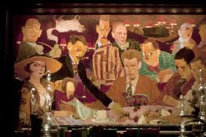
What are IRDs?

Slide 3
IAB Interpretation
Bring members together in intimate setting
Scene setters for debate and networking
Let participants control direction of conversation

Slide 4
IRDs Are a Good Business…
Good margins
Dinners can be “publisher facing” or “agency/marketer facing”
Sponsor pays for dinner and all logistics

Slide 5
But These are Essential
Good database to select invitees
Cooperative sponsors with managed expectations
Deliver promises to guests

Slide 6
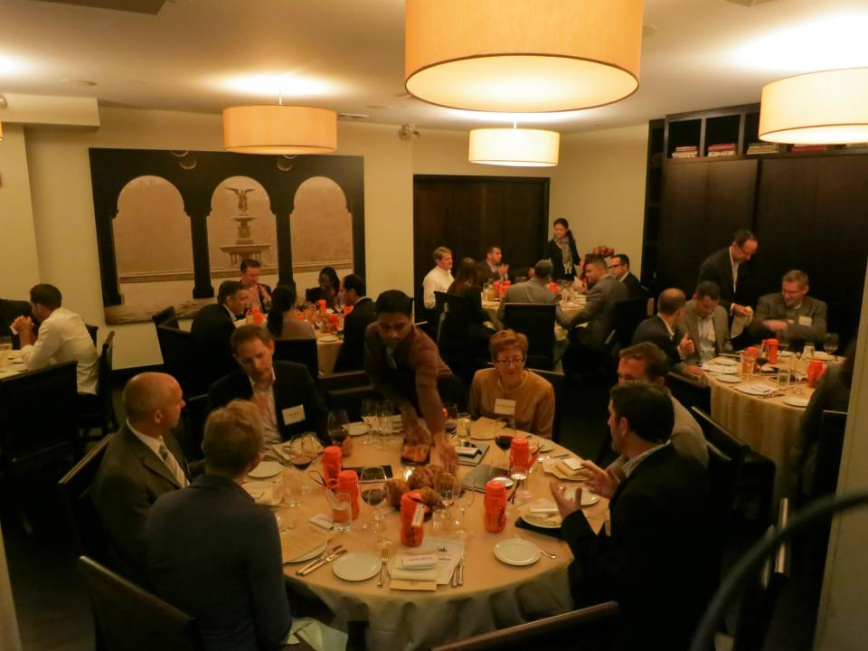
Room Set Up

Slide 7
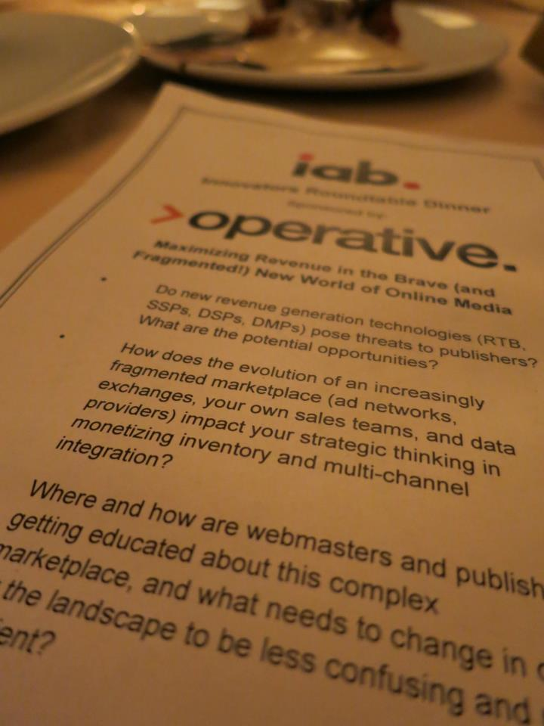
Execution
Pre-dinner
2 months before: Pick date, city, audience
1 month before: Select venue, create topic, send invites
Onsite
Network, eat, discuss
Post-dinner
Thank you notes

