Slide 1
Grow Your Revenue
IAB GLOBAL SUMMIT
IAB Certification and Training, Sponsored Dinners, Events, and More

Slide 2
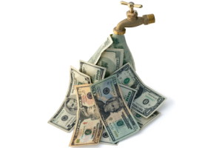
Revenue Streams
IAB GLOBAL SUMMIT
Membership Dues
Conferences and Events
Professional Development & Training
Compliance Programs
Certification
Sponsored Research
Centers of Excellence

Slide 3
Revenue Streams
IAB GLOBAL SUMMIT
Conferences and Events
Membership Dues
Conferences and Events
Professional Development & Training
Professional Development & Training
Compliance Programs
Certification
Sponsored Research
Certification
Centers of Excellence

