Slide 1
The Global Mobile Perspective
Marcus Startzel, GM North America

Slide 2
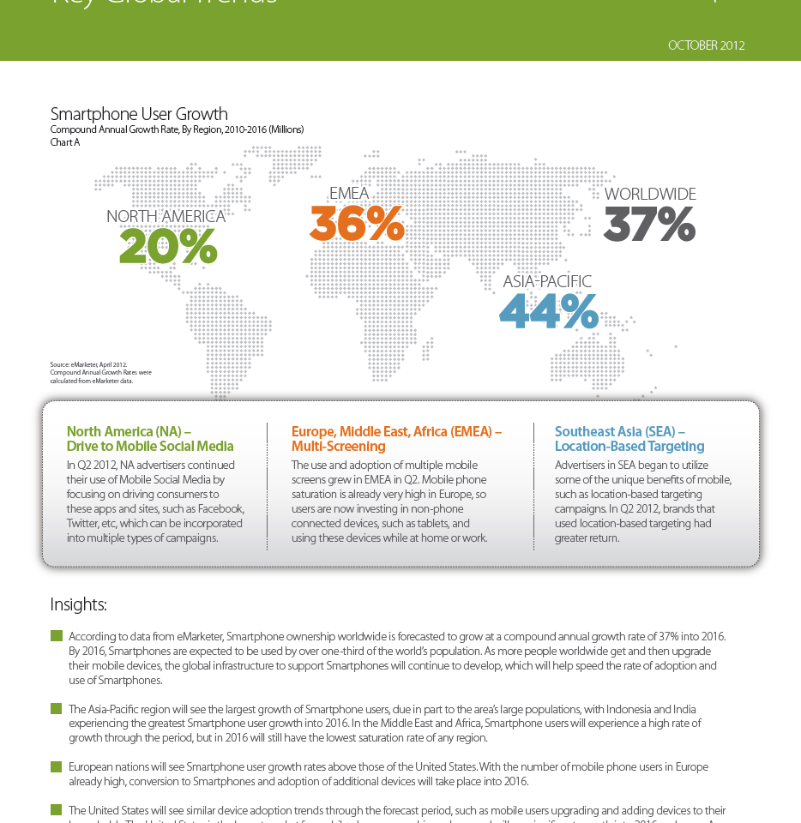
KEY GLOBAL TRENDS
By 2016, Smartphones are expected to be used by over one-third of the world’s population.
As this shift occurs, the global infrastructure to support Smartphones will continue to develop, which will speed the rate of adoption and use of Smartphones
Source: eMarketer, April 2012

Slide 3
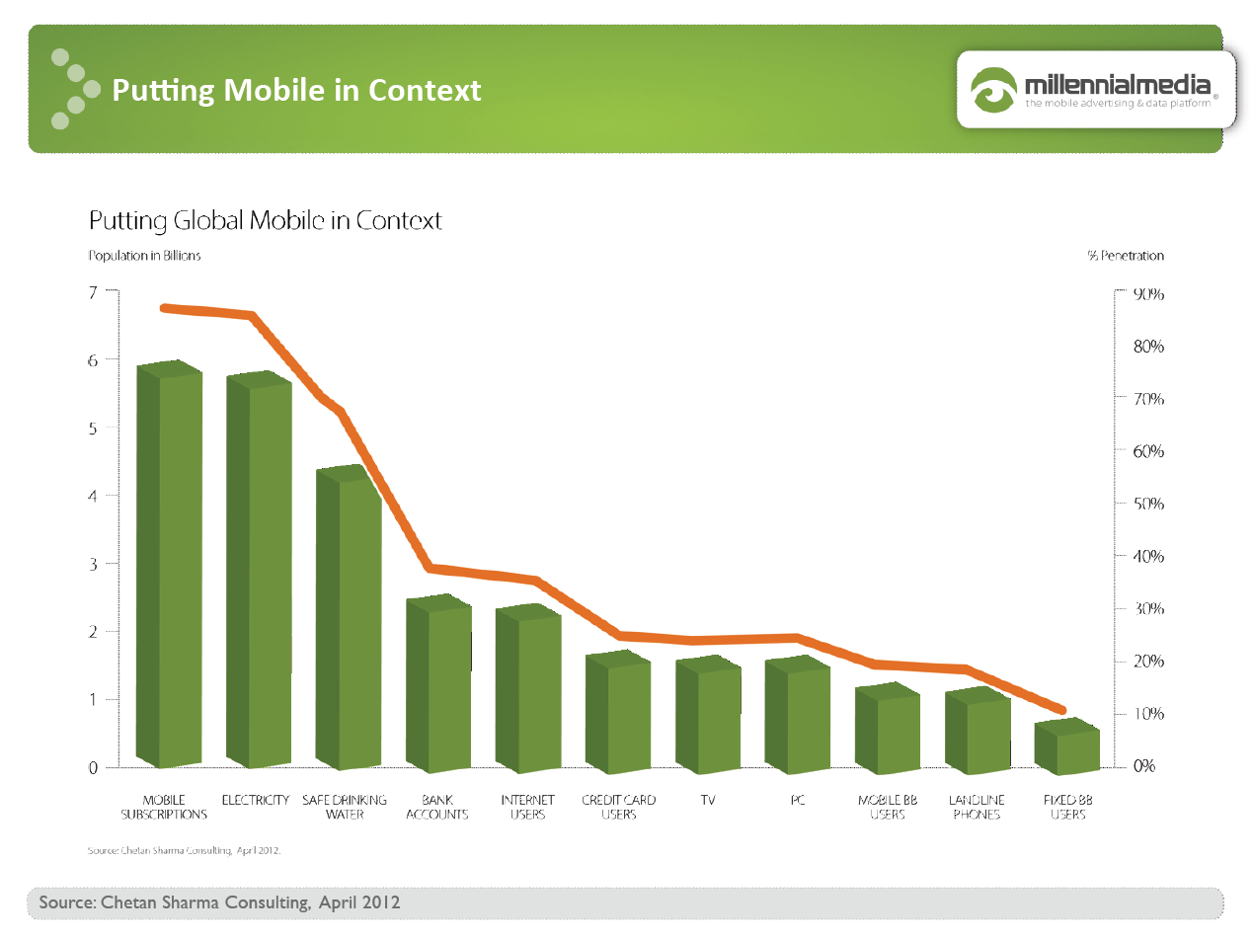

Slide 4
KEY GLOBAL TRENDS - NORTH AMERICA
The United States is the largest market for mobile phone ownership and use, and will continue to grow into 2016.
In Q2 2012, NA advertisers leveraged real world data to reach a variety of audiences. These audience targeting techniques allowed brands to connect with engaged consumers at the right time.
Source: eMarketer, April 2012

Slide 5
KEY GLOBAL TRENDS - EMEA
European nations will see Smartphone user growth rates above those of the US.
The use and adoption of multiple mobile screens grew in EMEA in Q2. Since Smartphone ownership is already high, users are now investing in non-phone connected devices, such a tablets.
Source: eMarketer, April 2012

Slide 6
KEY GLOBAL TRENDS – ASIA PACIFIC
The Asia-Pacific region will see the largest growth of Smartphones users, with Indonesia and India experience the greatest growth.
The Middle East and Africa will experience a high rate of growth, but will still have the slowest saturation rate of any region.
In Q2, 2012 SEA advertisers began to utilize location-based targeting campaigns.
Source: eMarketer, April 2012

Slide 7
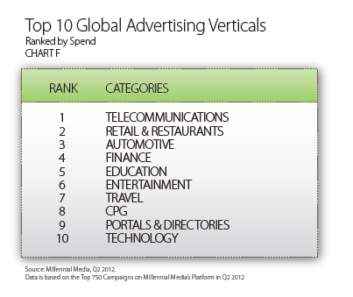
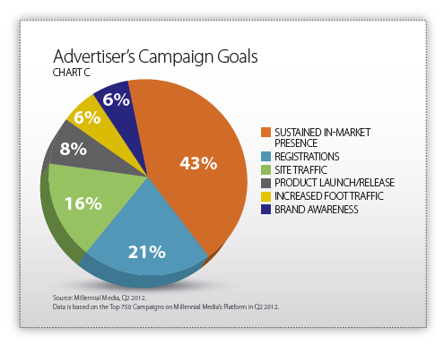
Key Stats

Slide 8

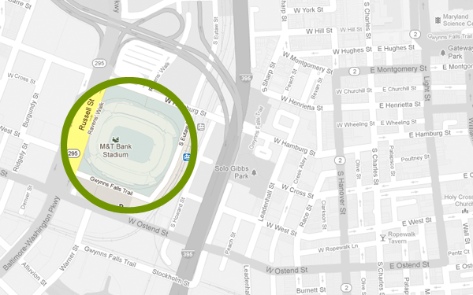



ADVERTISERS CAN USE LOCATION IN 2 WAYS
IMMEDIATE PROXIMITY
OBSERVED REAL-WORLD BEHAVIOR
HAS BEEN ON A CAR LOT
TARGETED AD DELIVERED
At the Staples Center
On a car lot
PROXIMITY TARGETING
“LOCATION OBJECT” IS WITHIN THE PROXIMITY CHOSEN BY ADVERTISER, 360° EXPERIENCE POSSIBLE
REAL-WORLD AUDIENCES
AUDIENCES ARE BUILT FROM ACTUAL BEHAVIOR DEMONSTRATED OVER TIME. ADS ARE DELIVERED BASED ON CAMPAIGN FLIGHTING

Slide 9
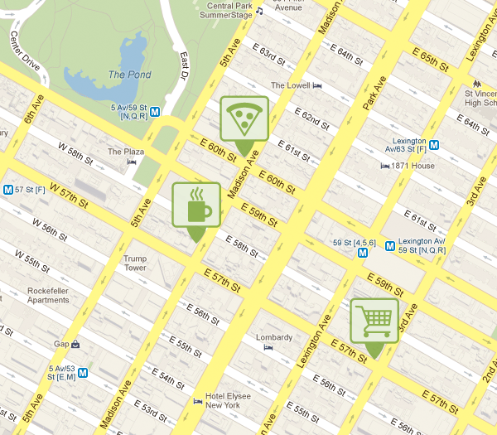
USING A POINT OF INTEREST (POI) DATABASE, WE MAP DATA TO REAL-WORLD MEANINGS
ESTABLISHING THE POINT OF INTEREST
LAT/LONG - 39.286258,-76.582475
=COFFEE SHOP (Starbucks)
LAT/LONG - 39.28047,-76.576574
= SUPERMARKET (Safeway)
LAT/LONG - 39.2815,-76.580222
= PIZZERIA (Pizza Hut)
~ 20M PLACES IN THE US
~ 60M PLACES IN 50 COUNTRIES

Slide 10
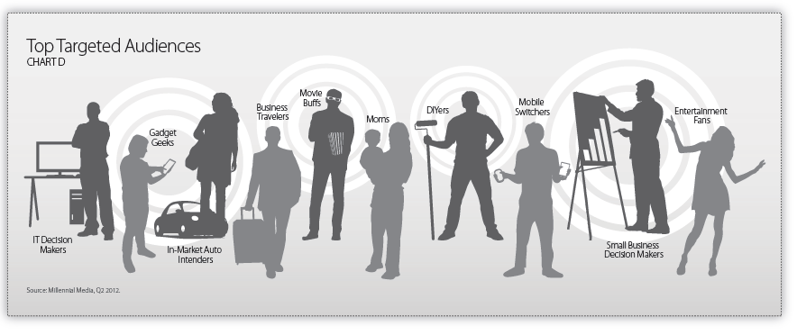
TOP TARGETED AUDIENCES BY GLOBAL ADVERTISERS

