Slide 1
Five Trends
Jay Sears, SVP Demand, the Rubicon Project
sears@rubiconproject.com
@jaysears
www.JaySears.com
IAB Global
October 3, 2012

Slide 2
Rubicon Project
Cloud-based technology platform used by comScore 1000 publishers to monetize digital ad inventory
Real Time Trading Platform
Leading marketplace
of digital ad buyers purchasing ad
inventory via
unified real-time
auction

Slide 3






































Largest independent marketplace of comScore 1000
Supply
Real Time Trading Platform
Demand
Premium Global Publishers
DSPs
Data and Algorithms
Real Time
Decisioning
Engine
Ad Networks
REVV for Publishers
REVV for Buyers
Infrastructure
400+ Publishers
1/3 of comScore 100
646M UV Reach
Annually:
1.7 Trillion Impressions
14.4 Trillion Bid Requests
50+ DSPs
350+ Ad Networks
70,000+ Advertisers

Slide 4





Our Focus: #6 – 1,000
comScore 6-25
Rank | Publisher | Total Display Ad Impressions (MM) | Share of Display Ads
6 | Glam Media | 7,694 | 1.7%
7 | ESPN | 5,520 | 1.3%
8 | Turner Digital | 5,375 | 1.2%
9 | eBay | 4,505 | 1.0%
10 | Amazon Sites | 4,108 | 0.9%
11 | Viacom Digital | 3,536 | 0.8%
12 | Weather Channel, The | 2,205 | 0.5%
13 | CBS Interactive | 2,142 | 0.5%
14 | New York Times Network | 1,997 | 0.5%
15 | Gannett Sites | 1,951 | 0.4%
16 | Fox News Digital Network | 1,912 | 0.4%
17 | DRUDGEREPORT.COM | 1,874 | 0.4%
18 | Comcast Corporation | 1,779 | 0.4%
19 | PANDORA.COM | 1,555 | 0.4%
20 | NFL Internet Group | 1,522 | 0.3%
21 | Mevio Network | 1,516 | 0.3%
22 | WildTangent Media | 1,467 | 0.3%
23 | MEDIATAKEOUT.COM | 1,371 | 0.3%
24 | TAGGED.COM | 1,353 | 0.3%
25 | Com Enterprises Inc. | 1,281 | 0.3%
Fragmented Markets Need Technology Platform to Power a Marketplace

Slide 5
Global Scale, The Largest Independent
#1 Global & US Reach
U.S. – U.K. – FRANCE –
GERMANY - AUSTRALIA

Slide 6
Five Trends

Slide 7
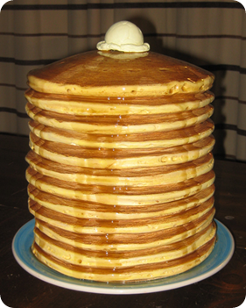
The Battle Up The Stack

Slide 8

The Smart Pipe Manifesto

Slide 9

Cross Media, Not Silos

Slide 10
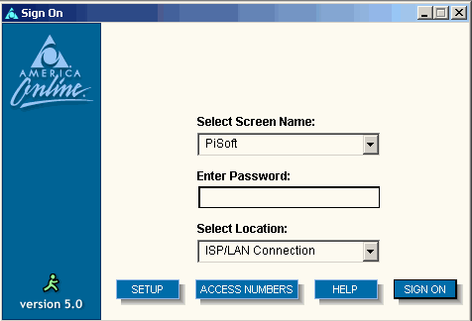
Closed 2.0 or Open 3.0?

Slide 11
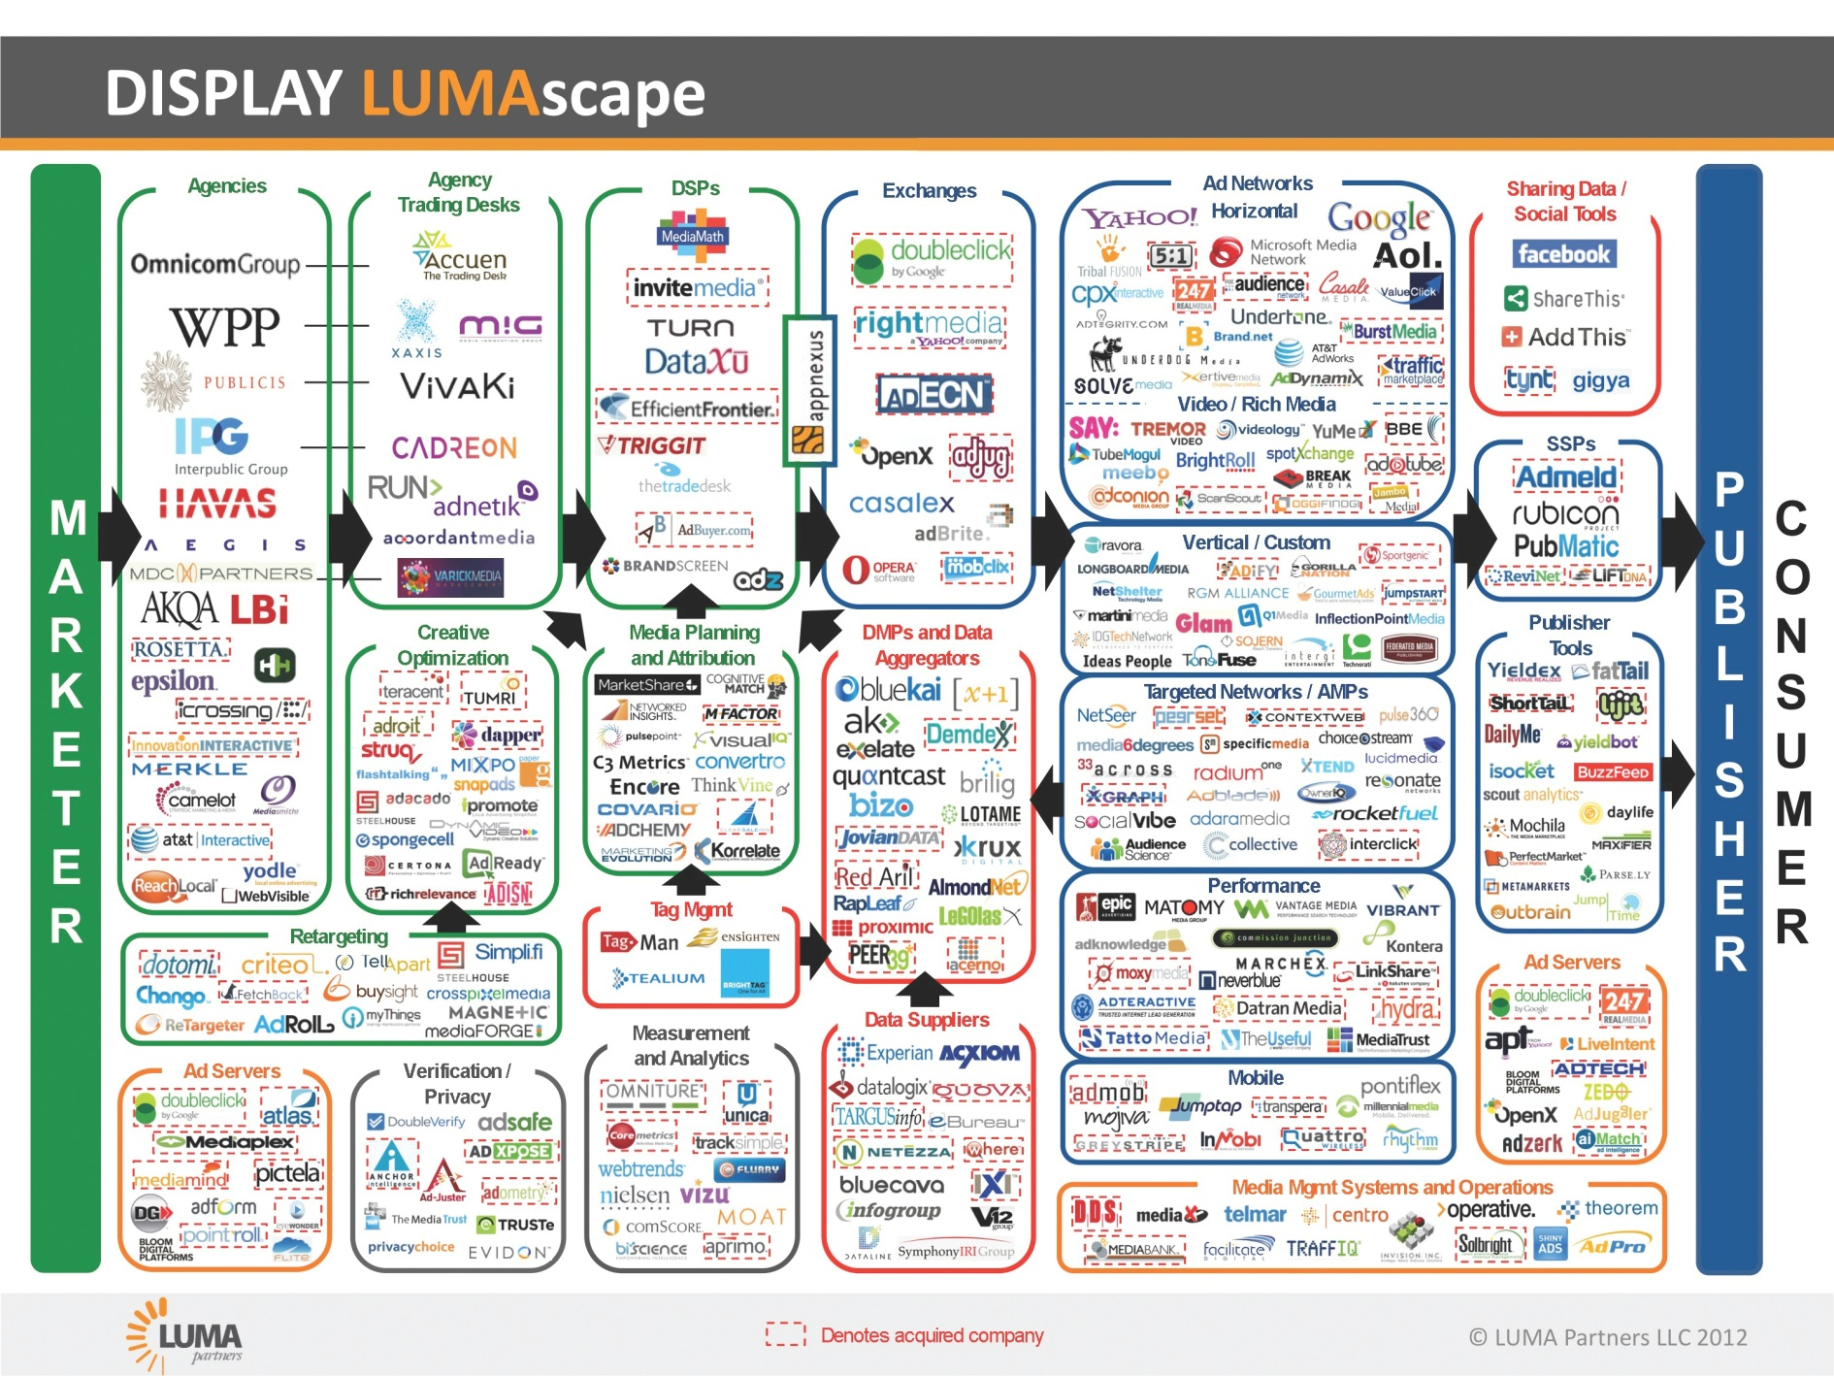



The Road to the Majors

Slide 12
The Battle Up The Stack
The SmartPipe Manifesto
Cross Media, Not Silos
Closed 2.0 or Open 3.0?
The Road to the Majors
Jay Sears, SVP Demand, the Rubicon Project
sears@rubiconproject.com
@jaysears
www.JaySears.com

