Slide 1
IAB Global Summit 2012 Harnessing the power of the Worldwide Network Guy Phillipson, CEO IAB UK

Slide 2
IAB is established Worldwide
Iab is now established in 36 counties around the world
We are a respected and professional Trade Association
Share of Ad revenue is well beyond critical mass – average 20%
Desire for knowledge and standards has never been higher

Slide 3
IAB has global assets
The OBA Framework and Adchoices Icon
International ad format standards
Ad spend data, including ADEX across Europe
Mediascope consumer data across 28 countries

Slide 4
Great potential to grow more global assets
Roll out Rising Stars formats
Global Ad spend data
The 3MS initative
Self regulatory guidelines for mobile
Tech standards for RTB Trading
International Training qualification
Ad Misplacement (DTSG) Best Practice

Slide 5
Digital Trading Standards Group – DTSG

Slide 6
DTSG – by the industry, for the industry
Representatives from each of the 9 organisation types (as identified as necessary to the DTSG).
A
D
V
E
R
T
I
S
E
R
P
U
B
L
I
S
H
E
R
DEMAND
SIDE PLATFORMS
AD NETWORK
SUPPLY
SIDE
PLATFORMS
AGENCY
AD
TRADING
DESK
AD EXCHANGE
SALES
HOUSE
Notes:
Advertiser (ISBA – Bob Wootton or David Ellison)
Agency (IPA – Pete Robins or Nigel Gwilliam)
Agency Trading Desk (TBA – from e.g. Xaxis, Vivaki, iProspect, Media Contacts)
Demand Side Platform (TBA – from e.g. Turn, Invite, Adnetik, MediaMath)
Ad Exchange (TBA – from e.g. Google DC AdEx, Rightmedia, OpenX, Appnexus)
Ad Network (Jemm/Microsoft)
Sales House (Ad2One/Eyeconomy)
Supply Side Platform (TBA – from e.g. Admeld, Intelligent Media, Pubmatic, Rubicon)
Publisher (AOP – Lee Baker or TBA)

Slide 7
DRAFT Good Practise Principles
The Provider/Facilitator should confirm that its best endeavour will be applied to minimise the risk of ad misplacement, irrespective of whether inventory is sourced directly or indirectly.
The Provider/Facilitator should explain the process(es) that form the basis of these best endeavours and will be subject to Principle 6.
The Provider/Facilitator should police this process, respond appropriately to misplacement via ad take down and understands the consequences of this not taking place.
A Primary Agreement should be entered into by both Provider and Recipient before trading commences.
A Primary Agreement will vary depending on the trading business model. However, it should include a standard tick box (see Annex I) to show that it is applying one of the following to minimise the risk of ad placement:
Content Verification (CV) tool (criteria agreed pre-delivery);
Appropriate / Inappropriate Schedules (criteria agreed pre delivery);
Reporting of destination URLs / Domains / Sub-Domains (supplied post-delivery).
These Principles are currently self-regulatory and prospectively binding on each Provider / Facilitator. Within six months of signifying support of these Principles, each Provider / Facilitator shall self-certify that the relevant portions of their business meet these Principles.

Slide 8
Current Models for sharing between IAB’s

Slide 9
Current Models for sharing between IAB’s
The CEE Programme meetings
The UK/US summer exchange programme
Open invitation to join IAB US councils
Distribution of (usually US) ad format standards
The IAB Europe Interact conference
The Mediascope Roadshow

Slide 10
Mediascope Europe - Overview
Notes:
Background
Coverage and Methodology
What’s available to IAB UK members?
Themes and topics
Some highlights!

Slide 11
Introduction
The broad aim of this study is to capture the different ways in which consumers are developing across Europe and assess their similarities and differences
Identify changing media consumption patterns
Evolution of media multi-tasking and emerging and evolving online media
Video consumption, social media and e-commerce
Conducted by IAB Europe
Contains 8 years of trending data, with new markets added

Slide 12
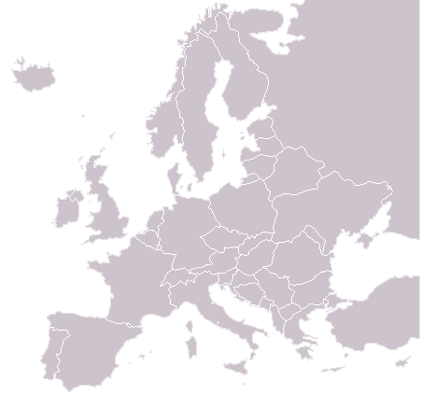
Coverage and methodology
Fieldwork took place in 28 markets in February 2012
An Omnibus + Online methodology was used across all countries totalling nearly 50,000 interviews
The application of quotas ensured that representative samples were achieved in each Market
quotas on age, gender, education and regional distribution were applied
Finland
Norway
Russia
Sweden
Czech
Republic
Denmark
Poland
Ireland
UK
Ukraine
Germany
Slovakia
Netherlands
Romania
Hungary
France
Bulgaria
Belgium
Turkey
Spain
Slovenia
Italy
Portugal
Greece
Switzerland
Austria
Croatia
Serbia

Slide 13
Topics & themes
The Media Evolution
Internet everywhere by any means
Media multi-tasking means more active consumers
Brand relationships grow via digital touchpoints
The Internet is an entertainer and enabler
Connectivity via mobile phones increasing engagement
Instant access to information at consumers fingertips
Internet enriches consumer communication
Online plays a key function in the purchase funnel

Slide 14
Let’s Harness IAB Worldwide!

Slide 15
There's so much more we could do
The time is right for global initiatives

