Slide 1
Shaping Our Future: A New Proposal for Global Collaboration
IAB Global Summit 2012
David Doty
New York City
October 3, 2012

Slide 2
IAB Is Already Global: 36 National IABs + Two Regionals
Europe
Austria
Belgium
Bulgaria
Croatia
Denmark
Finland
France
Germany
Greece
Hungary
Ireland
Italy
Netherlands
Norway
Poland
Romania
Russia
Serbia
Slovakia
Spain
Sweden
Switzerland
Turkey
UK
North America
Canada
Caribbean
Mexico
South America
Argentina
Brazil
Chile
Colombia
Peru
Uruguay
Southeast Asia + Pacific
Australia
New Zealand
Singapore
Vietnam
Regional
IAB Europe

Slide 3
Most National IABs Have Small Budgets…

Slide 4
…And Limited Staffs

Slide 5
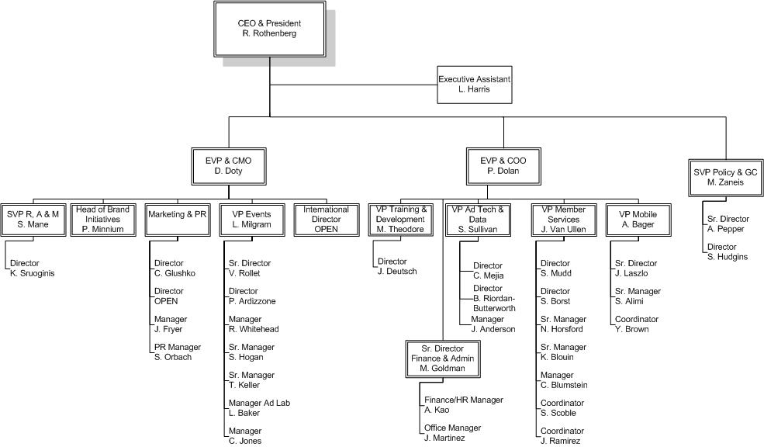
2012 IAB Budget: $16mm Staff: 44
Senior Leadership: 3 FTEs
Events: 8 FTEs
Member Services: 8 FTEs
Advertising Technology: 4 FTEs
Mobile Marketing Center of Excellence: 4 FTEs
Public Policy: 3 FTEs
Marketing & Social Media: 4 FTEs
Research, Analytics & Measurement: 2 FTEs
Training & Development: 2 FTEs
Finance & Administration: 4 FTEs
Brand Initiatives: 1 FTE
International: 1 FTE

Slide 6
Our Proposal: A New Collaboration With Our International Partners
Create a new membership category – “International Members” – and open it to the largest and most influential member companies of national IABs, at no additional charge beyond what members already pay in national dues
Participate in our 19 Committees and Councils
Help establish global technical standards and operating best practices
Bring IAB Sales Certification training and accreditation to your markets
Partner on market-making research and thought-leadership publishing
Market your successes through a new, curated IAB Global Website and App
Assert leadership through an enlarged IAB International Steering Committee
Build your events businesses with programming and support from the IAB Events team

Slide 7
Let’s Get It Done
Your Ideas Welcome!

Slide 8
Thank You
david@iab.net

